Slide 1
Electrical Faults Analysis & Classification
Team members:
Sangamithraa-CB.EN.U4EEE22040
S.Harshitha-CB.EN.U4EEE22136
Paroma dhara-CB.EN.U4EE22126

Slide 2
Introduction:
Electrical fault detection and classification are critical for ensuring the reliability and safety of power systems. Traditional fault classification methods rely on predefined rules and threshold-based techniques, which often struggle with complex grid conditions and non-linear fault patterns. This project leverages machine learning (ML) techniques to automate and enhance fault classification based on electrical current and voltage data.

Slide 3
OBJECTIVE:
The primary goal of this project is to develop an accurate and efficient fault classification system that can analyze electrical parameters, detect anomalies, and classify faults into predefined categories. The system is designed to:
Identify Fault Types: Detect and categorize faults such as Line-to-Ground (LG), Line-to-Line (LL), and Three-Phase Faults.
Improve Classification Accuracy: Utilize ML models like Logistic Regression, Random Forest, and XGBoost to enhance detection precision.
Analyze Performance: To analyze the model and understand its efficiency.

Slide 4
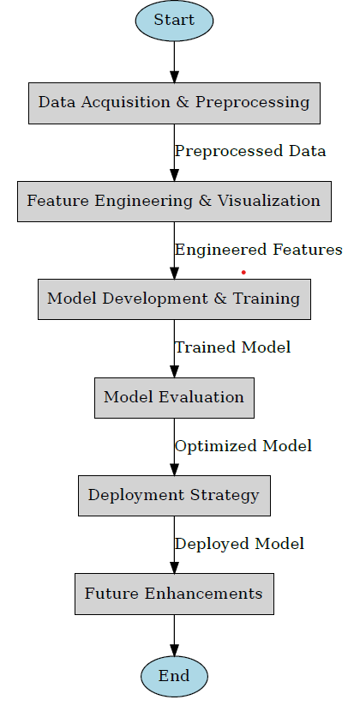
FLOWCHART
Start – The process begins with defining the objective of fault classification.
Data Acquisition & Preprocessing – Collects electrical data (current & voltage) and cleans it (handling missing values, normalization, etc.).
Feature Engineering & Visualization – Extracts important features and visualizes data patterns for better understanding.
Model Development & Training – Uses machine learning algorithms (Logistic Regression, Random Forest, XGBoost) to train a fault classification model.
Model Evaluation – Tests the trained model using accuracy, F1-score, and confusion matrices to measure its effectiveness.
Deployment Strategy – Plans how to implement the trained model in real-world applications (e.g., smart grids, industrial systems).
Future Enhancements – Considers improvements such as real-time processing, edge computing, or additional optimizations.
End – The process is completed, with potential for future upgrades.

Slide 5
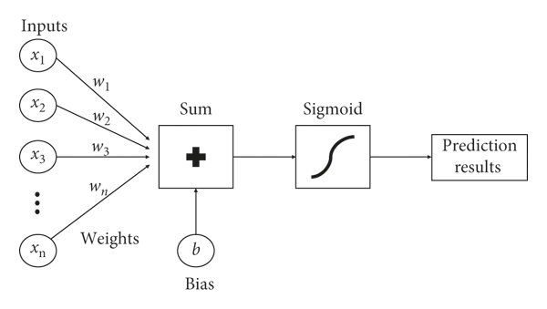
Logistic regression
Step 1: Inputs and Weights
The model receives multiple input features x1​,x2​,...,xn​.
Each input has an associated weight ​,w2​,...,wn​ that determines its importance.
Step 2: Weighted Sum Computation
The inputs and weights are combined into a weighted sum:
z=(x1⋅w1+x2⋅w2+...+xn⋅wn)+b
The bias term b is added to adjust the decision boundary.
Step 3: Sigmoid Activation Function
The sigmoid function is applied to the weighted sum to convert it into a probability:
The sigmoid function ensures the output is between 0 and 1, making it interpretable as a probability.
Step 4: Prediction Results
σ(z)>0.5 → The model predicts class 1 (e.g., spam, positive).
σ(z)≤0.5 → The model predicts class 0 (e.g., non-spam, negative).

Slide 6
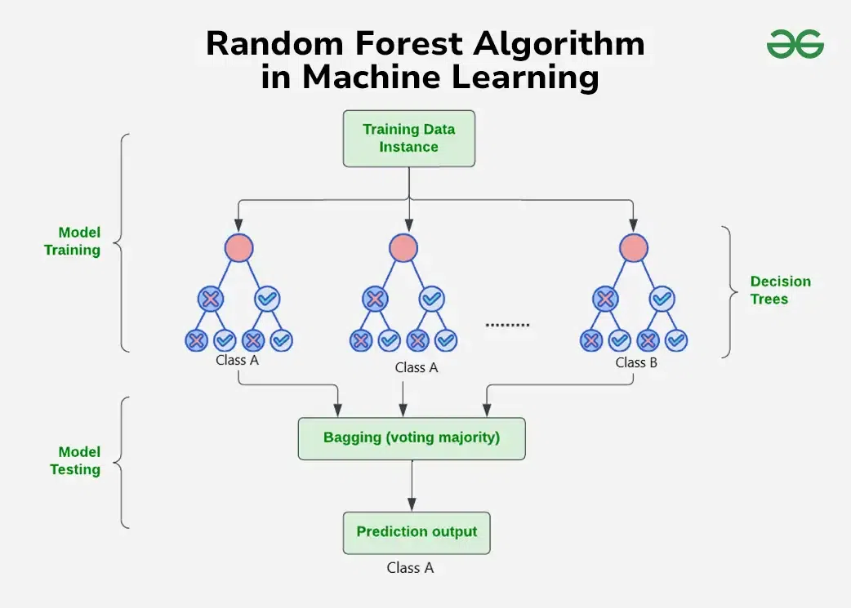
Random Forest is a supervised machine learning algorithm widely used for classification and regression tasks. It is an ensemble learning method that operates by constructing multiple decision trees during training and combining their outputs to improve accuracy
Bootstrap Sampling (Bagging)
The algorithm randomly selects different subsets of the training dataset with replacement (bootstrap sampling).
Each subset is used to train an individual decision tree.
Feature Randomness (Feature Selection per Split)
Instead of considering all features at each node, a random subset of features is selected.
This introduces more diversity among trees, reducing correlation and improving generalization.
Training Multiple Decision Trees
Multiple decision trees are trained independently using different bootstrapped datasets and feature subsets.
Voting (Classification) / Averaging (Regression)
For classification, each tree votes on the class label, and the majority vote determines the final prediction.
For regression, the predictions from all trees are averaged.

Slide 7
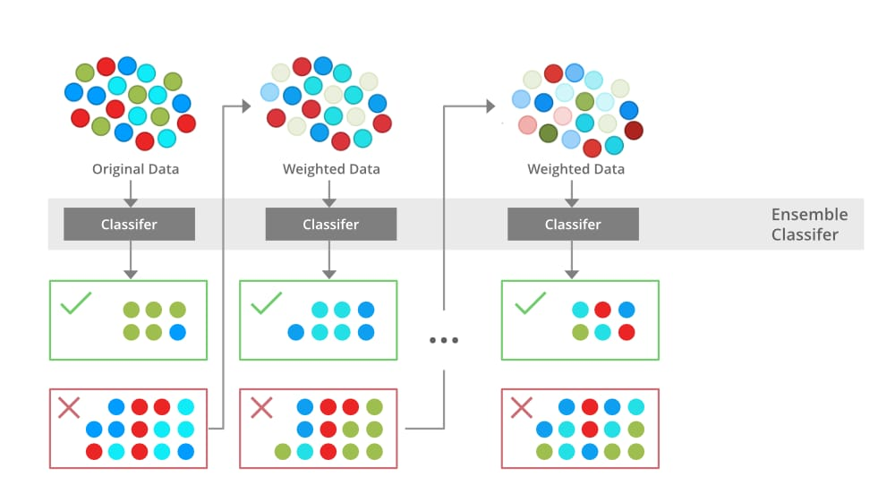
The diagram illustrates the architecture of a Gradient Boosting Decision Tree (GBDT), specifically the working of XGBoost (Extreme Gradient Boosting). XGBoost is a powerful ensemble learning technique that improves prediction accuracy by sequentially training multiple decision trees, each correcting the errors of the previous one.

Slide 8
Step 1: Data Set Preparation
The Dataset (D) is divided into smaller subsets (D₁, D₂, …, Dₙ).
Instead of training trees on the entire dataset independently, XGBoost learns iteratively, focusing on reducing errors.
Step 2: Construction of Decision Trees
The first decision tree (Tree_1) is trained on the dataset, making initial predictions.
After training Tree_1, residual errors (difference between actual and predicted values) are calculated.
The next tree (Tree_2) is trained on these residuals to minimize the error.
This process repeats, with each new tree focusing on the errors of the previous tree.
Step 3: Residual Learning
Each tree tries to correct the mistakes of the previous tree by learning from residual errors.
The residuals (errors) act as the target variable for training the next tree.
New trees are added until the model reaches the optimal performance.
Step 4: Summing Up Results
Once all trees are built, their predictions are combined (summed or averaged) to get the final result.
In classification problems, the final prediction is determined through weighted majority voting.
In regression problems, predictions are summed to get the final output.
Step 5: Final Output
The final output represents the optimized prediction, incorporating all trees' contributions.
Since each tree focuses on minimizing errors, XGBoost achieves high accuracy and reduced bias.

Slide 9
Program implementation:
1. Data Input Load two datasets: Training data (classData.csv) Validation data (detect_dataset.csv) 2. Fault Labeling Analyze current measurements (Ia, Ib, Ic, In) Assign fault labels (e.g., LG, LL, No Fault) based on predefined rules 3. Data Preparation Clean data: Fill missing values (median/KNN) Encode labels: Convert text labels (LG, LL) to numbers (0, 1) Split data: 80% → Training 20% → Testing (preserve fault ratios)

Slide 10
4. Exploratory Analysis Class distribution: Check fault type frequencies Correlations: Identify relationships between currents 5. Model Training Train three models: Logistic Regression (Baseline) Random Forest (Non-linear patterns) XGBoost (High accuracy for imbalanced data) 6. Evaluation Metrics: Accuracy Precision/Recall per fault type F1-score (weighted average)

Slide 11
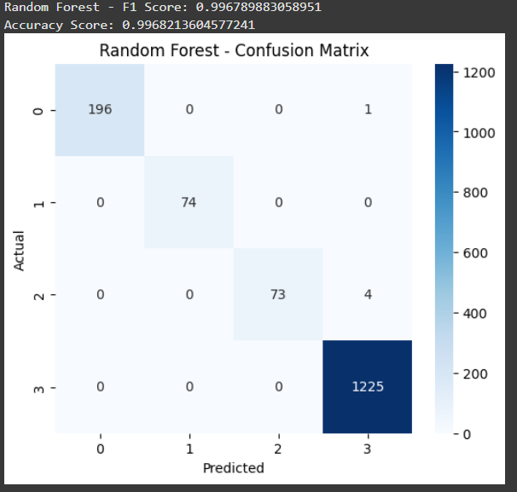
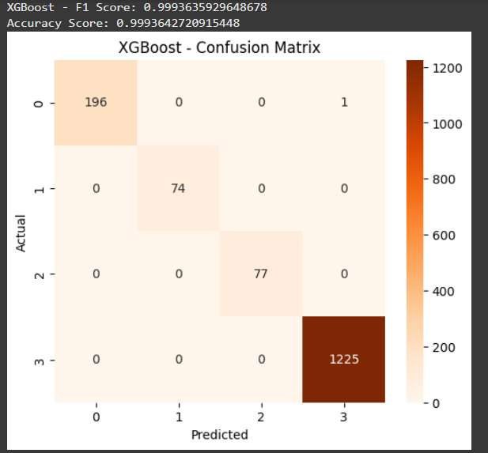
Result and discussion:

Slide 12
Why Choose XGBoost and Random Forest
. Random Forest:
Robustness: Works well with both small and large datasets without overfitting.
Feature Importance: Can rank the significance of input features.
Handles Missing Data: Can work with incomplete data more effectively than some other models.
Ensemble Learning: Uses multiple decision trees to improve accuracy and reduce variance.

Slide 13
XGBoost:
Efficiency: Uses parallel processing and optimized algorithms for fast execution.
Higher Accuracy: Outperforms traditional ML models in many real-world datasets.
Regularization: Avoids overfitting better than traditional boosting algorithms.
Handles Class Imbalance: Effective in scenarios where fault types are unevenly distributed.
By using both Random Forest and XGBoost, we achieve a balance between interpretability and high accuracy, ensuring reliable electrical fault classification.

Slide 14
CONCLUSION
This project successfully classifies electrical faults using machine learning models. Data preprocessing, feature engineering, and model training were implemented efficiently, with XGBoost and Random Forest achieving the best performance. The models were evaluated using accuracy, F1-score, and confusion matrices to ensure reliability.
Future improvements can include:
Real-time implementation using IoT-based fault detection.
Integration with cloud or edge computing for faster response.
Further tuning of hyperparameters to improve accuracy.

